Slide 1
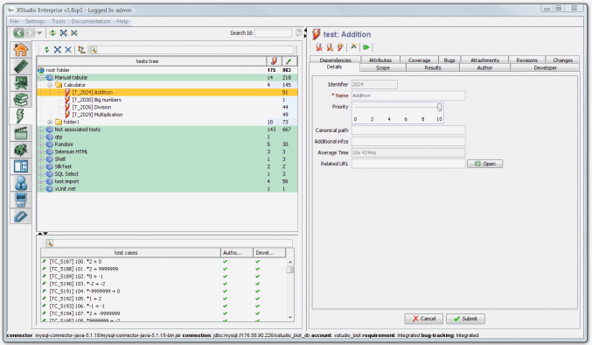

XSudio
Test management tool
Team: Star of Sierra Leone
Milena Bozhanova, Georgi Georgiev, Georgi Stoykov, Stefan Hristov, Miroslava Andonova
Telerik QA Academy

Slide 2

About
XQual Studio (XStudio) is free Application lifecycle management (ALM) solution. It is 100% graphical and modular in design test management application that handles the complete lifecycle of QA/testing projects from end to end: users, requirements, specifications, documents, test plans, test reports, test case and bugs.

Slide 3
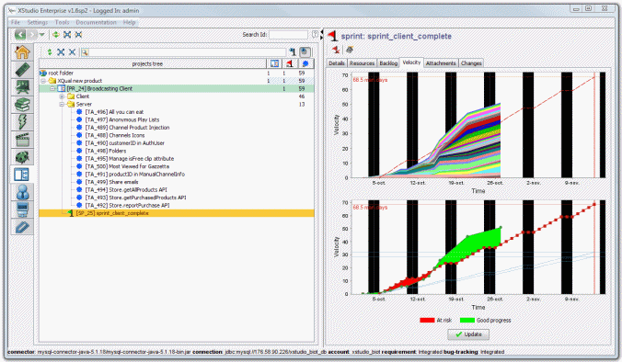
Main features(1)
Document sharing (including versioning and locking capabilities)
Customization of all generated documents (testplans, test reports etc.)
Attachments on requirements, specifications, tests, test cases, defects, folders/container
User profile and teams customization (rights management)

Slide 4
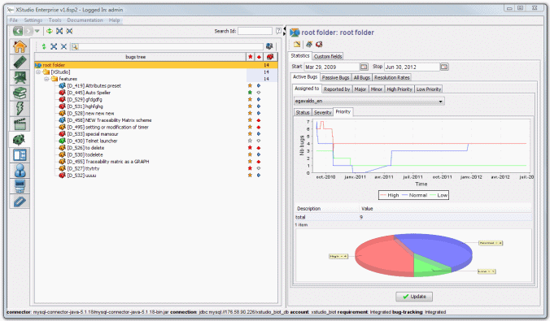
Main features(2)
Custom fields (add-on)
Support for automated and manual tests execution
Connectors to the most famous bug-tracking systems (Generic, JIRA, Trac, Bugzilla, Mantis)
Versioning and locking mechanism on attachments

Slide 5




Main features(3)
Email notifications (test reports, status changes, defects changes etc.)
Powerful search engine
Embedded spell-checker
Test case parametrization (including pairwise algorithm)
Languages - English, French, Spanish, German, Italian, Chinese
iPhone/iPad apps

Slide 6


Open-Source launchers
30+ different launchers to execute automated tests
Notes:
http://www.xqual.com/open_source/launchers.html

Slide 7
XStudio
?
?
?
?
?
Questions?
?
?
?
?
?
?

